Slide 1


Salman Al Gahuri
November 20, 2024

Slide 2

Outline
Executive Summary
Introduction
Methodology
Results
Conclusion
Appendix

Slide 3
Executive Summary
Summary of used methodologies
- Data Collection through API
- Data Collection with Web scraping
- Data Wrangling
- Exploratory Data Analysis with SQL
- Exploratory Data Analysis with Data Visualization
- Interactive Visual Analytics with Folium
- Machine Learning Prediction
Summary of all results
- Exploratory Data Analysis results
- Interactive Analytics in screenshots
- Predictive Analytics results

Slide 4
Introduction
SpaceX advertises Falcon 9 rocket launches on its website with a cost of 62 million dollars; other providers cost upward of 165 million dollars each, much of the savings is because SpaceX can reuse the first stage. Therefore if we can determine if the first stage will land, we can determine the cost of a launch. This information can be used if an alternate company wants to bid against SpaceX for a rocket launch. The goal is to create machine learning pipeline to predict if the first stage will land successfully.
We can use Data Science and Machine Learning in order to find:
What elements decide whether the first stage will successfully land?
What operating conditions needs to be in place to ensure a successful landing program?

Slide 5

Section 1

Slide 6
Methodology
Executive Summary
Data collection methodology:
Data was collected from SpaceX API and Web Scraping from Wiki Pages
Perform data wrangling
Data was first converted to a pandas dataframe then One-hot encoding was applied to categorical variables
Perform exploratory data analysis (EDA) using visualization and SQL
Perform interactive visual analytics using Folium and Plotly Dash
Perform predictive analysis using classification models
Use machine learning to predict if the first stage will land successfully

Slide 7
Data Collection
SpaceX REST API
Get Request
Get data as a JSON object
Convert JSON object to pandas dataframe
Data was collected from SpaceX API and web scraped from wiki pages.
Web Scraping Falcon 9 web records
Use BeautifulSoup to web scrape HTML tables
Parse data from tables
Convert tables to pandas dataframe

Slide 8
Data Collection – SpaceX API
SpaceX API endpoint
Get Request
Extract needed information
Get the JSON then converted to pandas dataframe
Filter the dataframe and delete Falcon 1 launches
Deal with missing values
Data wrangling
We used the get request to the SpaceX API to collect and clean the data, as well as wrangling the data and dealing with missing values
SpaceX Data Collection Notebook

Slide 9
Data Collection - Scraping
Data Wrangling
Request Falcon 9 web page using its URL
Use BeautifulSoup object from the response
Extract all HTML tables
Create the needed dataframe from the HTML tables
Performed web scraping to Falcon 9 launch records from web pages.
Web Scraping Data Collection Notebook

Slide 10
Data Wrangling
Identify Missing Values
Identify numerical and categorical variables
Calculate the number of launches as well as the occurrence of each orbit
Calculate the number of missing landing outcome in total and for each orbit
Create landing output label as 0 and 1 for failure and success respectively
Data Wrangling Notebook

Slide 11
EDA with Data Visualization
Summary of plotted charts:
Catplot to visualize how Flight Number and Payload effect the landing outcome.
Catplot to visualize how Flight Number and Launch Site effect the landing outcome.
Catplot to visualize how Launch Site and Payload effect the landing outcome.
Barchart to visualize the success rate of each Orbit type.
Catplot to visualize how Flight Number and Orbit type effect the landing outcome.
Catplot to visualize how Orbit type and Payload effect the landing outcome.
Linechart to visualize the launch success yearly rate.
Data Visualization Notebook

Slide 12
EDA with SQL
SQL Queries Performed:
Display the names of distinct Launch Sites
Display 5 records where launch sites begin with the string 'CCA'
Display the total payload mass carried by boosters launched by NASA (CRS)
Display average payload mass carried by booster version F9 v1.1
List the date when the first succesful landing outcome in ground pad was acheived.

Slide 13
EDA with SQL
SQL Queries Performed: SQL Notebook
List the names of the boosters which have success in drone ship and have payload mass greater than 4000 but less than 6000
List the total number of successful and failure mission outcomes
List the names of the booster_versions which have carried the maximum payload mass. Use a subquery
List the records which will display the month names, failure landing_outcomes in drone ship ,booster versions, launch_site for the months in year 2015.
Rank the count of landing outcomes (such as Failure (drone ship) or Success (ground pad)) between the date 2010-06-04 and 2017-03-20, in descending order.

Slide 14
Build an Interactive Map with Folium
Summary of created map objects to the Folium map:
Created and added folium.Circle and folium.Marker for each launch site on the site map and added a text labe for each of the.
MarkerCluster object to simplify the map containing many markers at the same coordinates.
MousePosition object to show the coordinates when you hover over the map.
Folium.polyline to draw a line between two coordinates on the map.
Folium Notebook

Slide 15
Build a Dashboard with Plotly Dash
Summary of plots/graphs and interactions added to the dashboard:
The dashboard contains input components such as a range slider and a dropdown list.
The dropdown list let choose one of the four Launch Sites.
A Callback function is created to render a Success-PieChart depending on the selected Launch Site.
The ranger slide able us to easily select a payload range.
Another Callback function is created to render a Success-Payload-ScatterChart using the payload range as an input.
Dashboard Code Notebook

Slide 16
Predictive Analysis (Classification)
The process to develop the best model to predict the landing outcome:
Load the Data
Use the data to create column Y representing landing outcome with values 0 and 1
Split the data into training and testing sets
Create Logistic Regression, SVM, Decision Tree, KNN and GridSearchCV objects
Train the different models using the training set
Test the models and find the model that perform the best
Model Development Notebook

Slide 17
Results
Exploratory data analysis results
Interactive analytics demo in screenshots
Predictive analysis results

Slide 18

Section 2

Slide 19
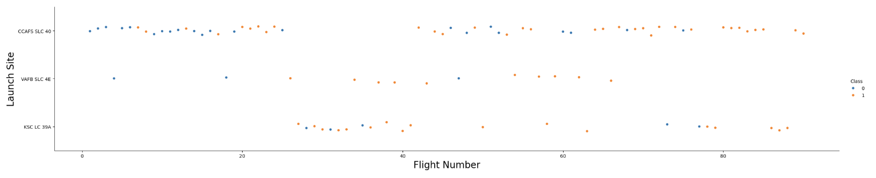
Flight Number vs. Launch Site
We notice the successful landing rate increases with more launches for all launch sites but especially for the CCAFS SLC 40 site.
Also, we notice VAFB SLC 4E and KSC LC-39A sites has a higher success rate but less launches than CCAFS SLC 40 site.

Slide 20
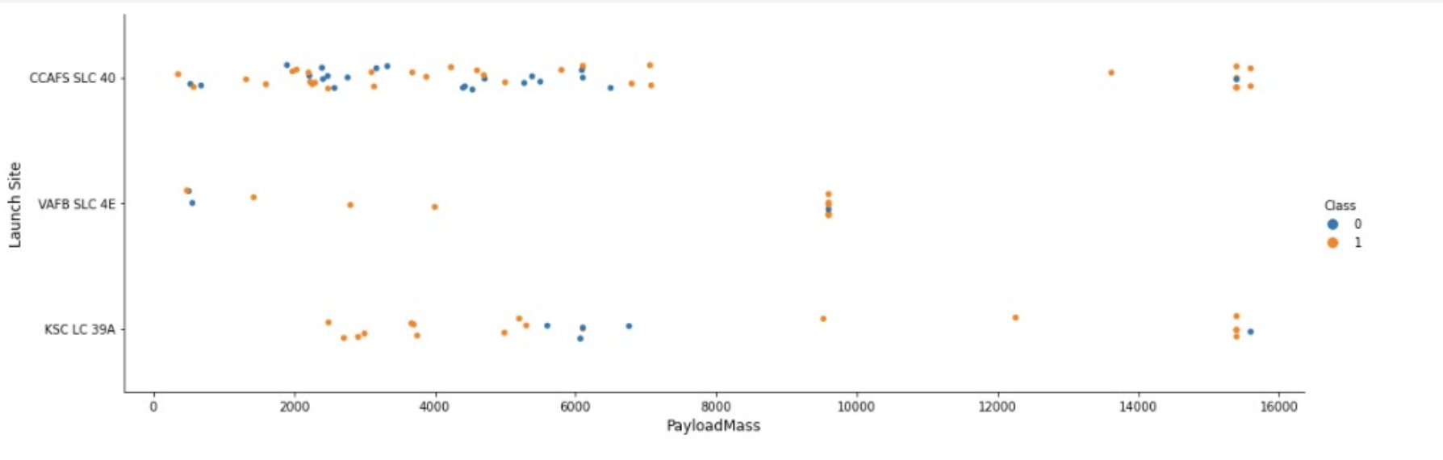
Payload vs. Launch Site
The VAFB SLC 4E site doesn't have launches with Payload Mass over 10,000 kg.
Most of the CCAFS SLC 40 site launches has Payload Mass less than 8,000 kg and few launches more than 13,000 kg mass.

Slide 21
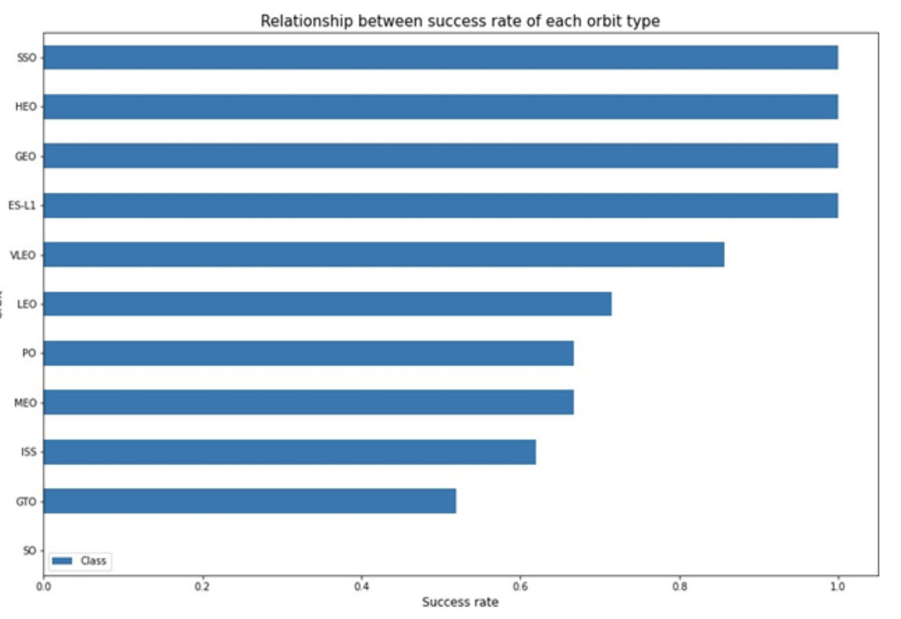
Success Rate vs. Orbit Type
These are the launch sites with the best success rates.
Notice that some of these sites has fewer launches than others.

Slide 22
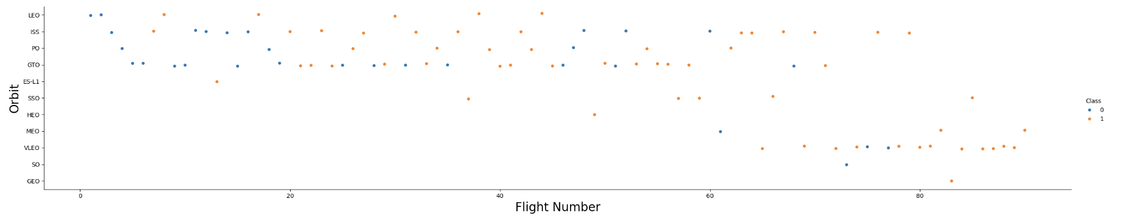
Flight Number vs. Orbit Type
Success rate increases with more launches for all sites.
Orbits with fewer launches has better success rate.

Slide 23
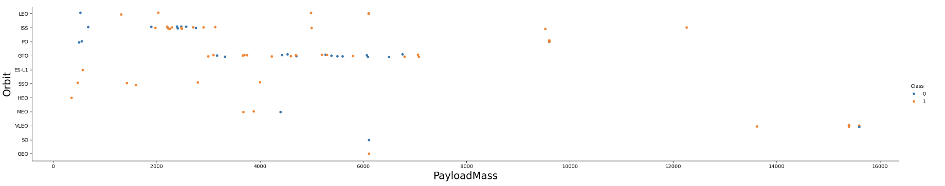
Payload vs. Orbit Type
Success rate are higher for launches with greater Payload Mass.
GTO site has mixed outcomes and doesn't have launches with higher Payload Mass.

Slide 24
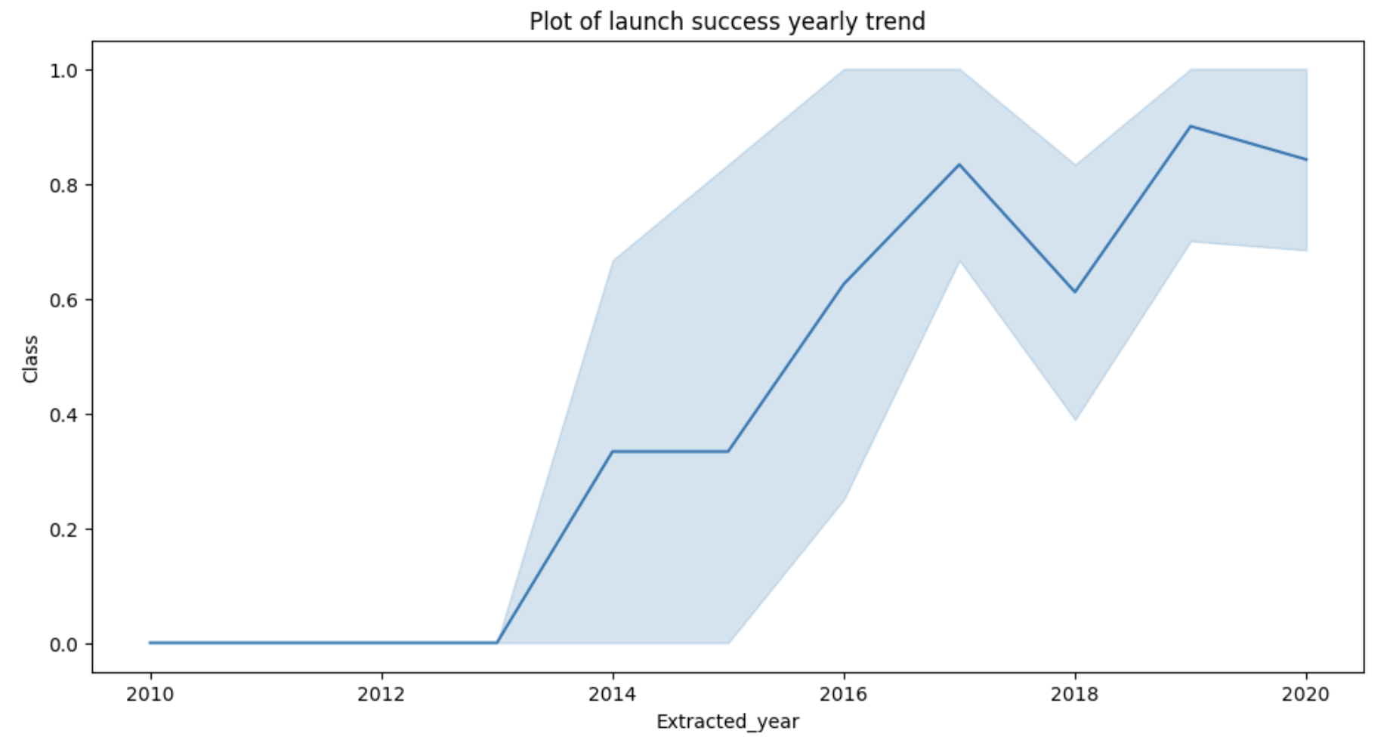
Launch Success Yearly Trend
We can observe that the success rate since 2013 kept increasing till 2020

Slide 25
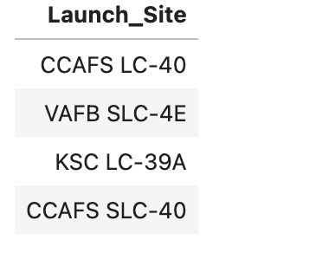
All Launch Site Names
There are four distinct Launch Sites in the collected data.

Slide 26
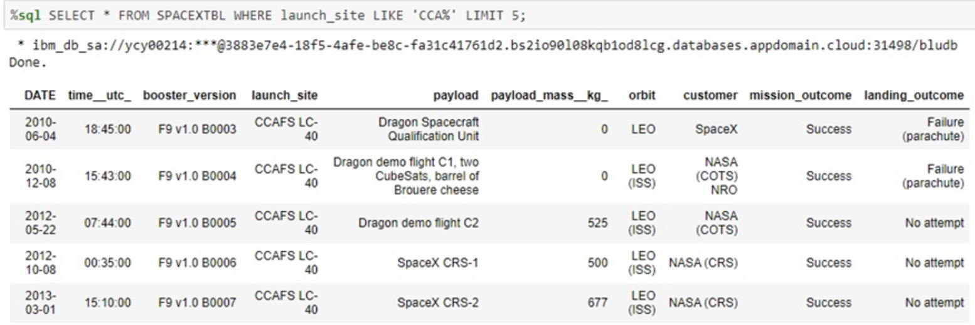
Launch Site Names Begin with 'CCA'
5 records of launch sites starts with the string 'CCA'.

Slide 27
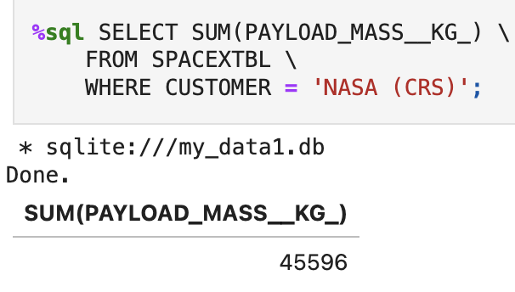
The total payload mass carried by boosters launched by NASA (CRS)
Total Payload Mass

Slide 28
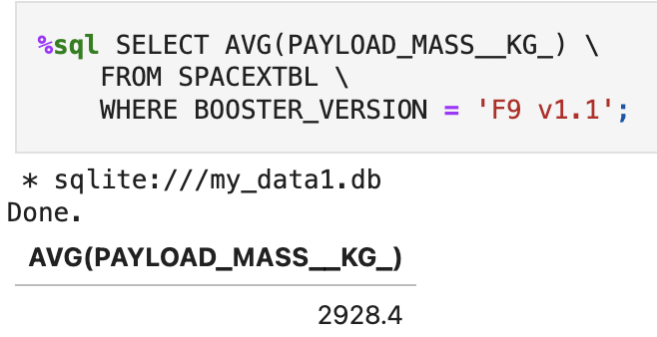
Average Payload Mass by F9 v1.1
The average payload mass carried by booster version F9 v1.1

Slide 29
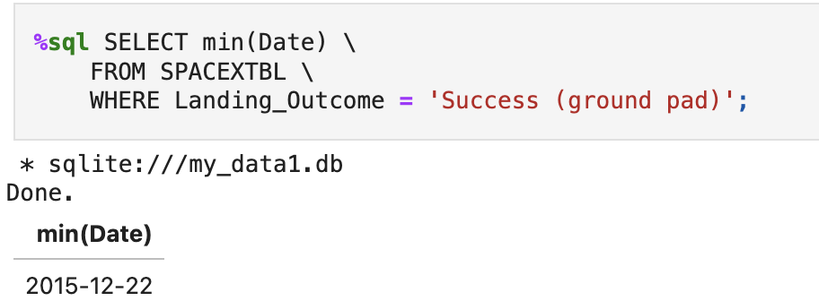
First Successful Ground Landing Date
The date when the first successful landing outcome in ground pad was achieved.

Slide 30
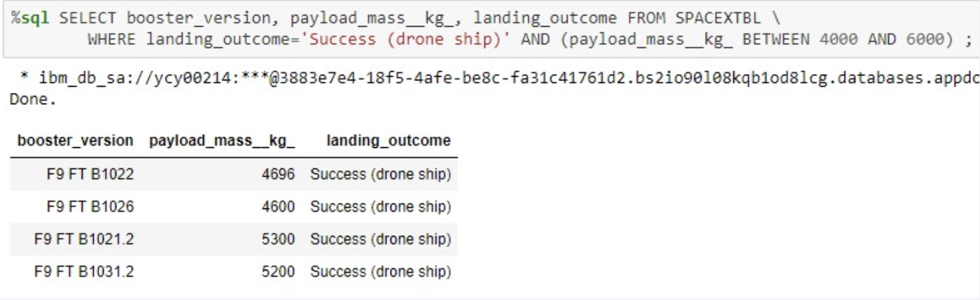
Successful Drone Ship Landing with Payload between 4000 and 6000
The names of boosters which have successfully landed on drone ship and had payload mass greater than 4000 but less than 6000

Slide 31
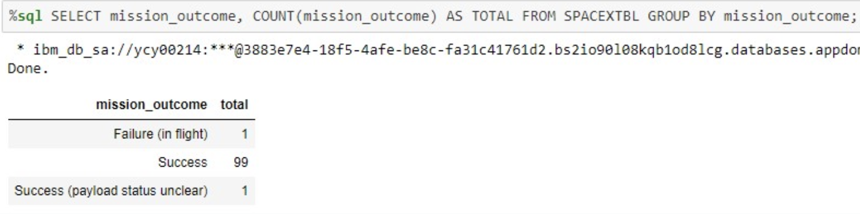
Total Number of Successful and Failure Mission Outcomes
The total number of successful and failure mission outcomes.

Slide 32
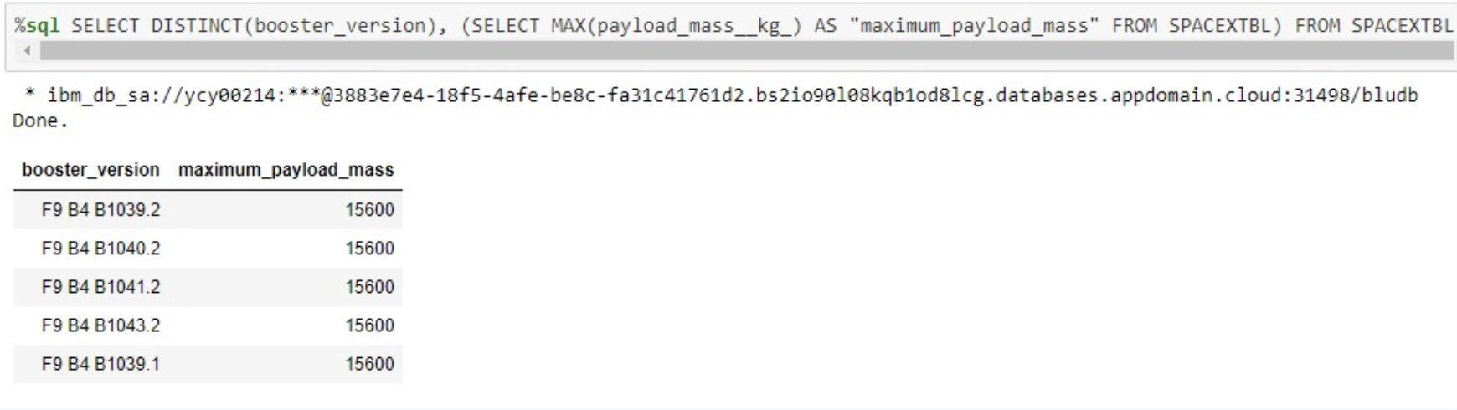
Boosters Carried Maximum Payload
The names of the booster_versions which have carried the maximum payload mass using a subquery.

Slide 33
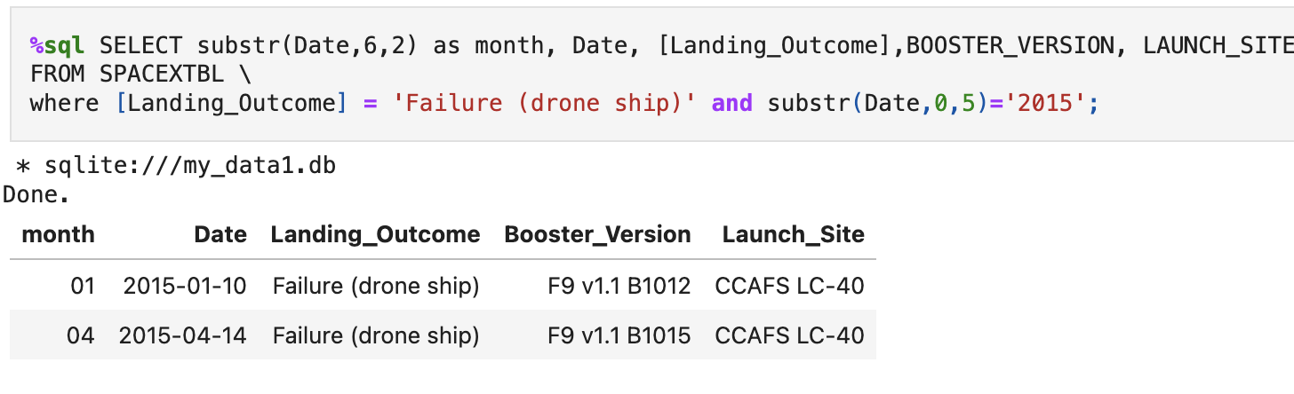
2015 Launch Records
The failed landing_outcomes in drone ship, their booster versions, and launch site names for in year 2015.

Slide 34
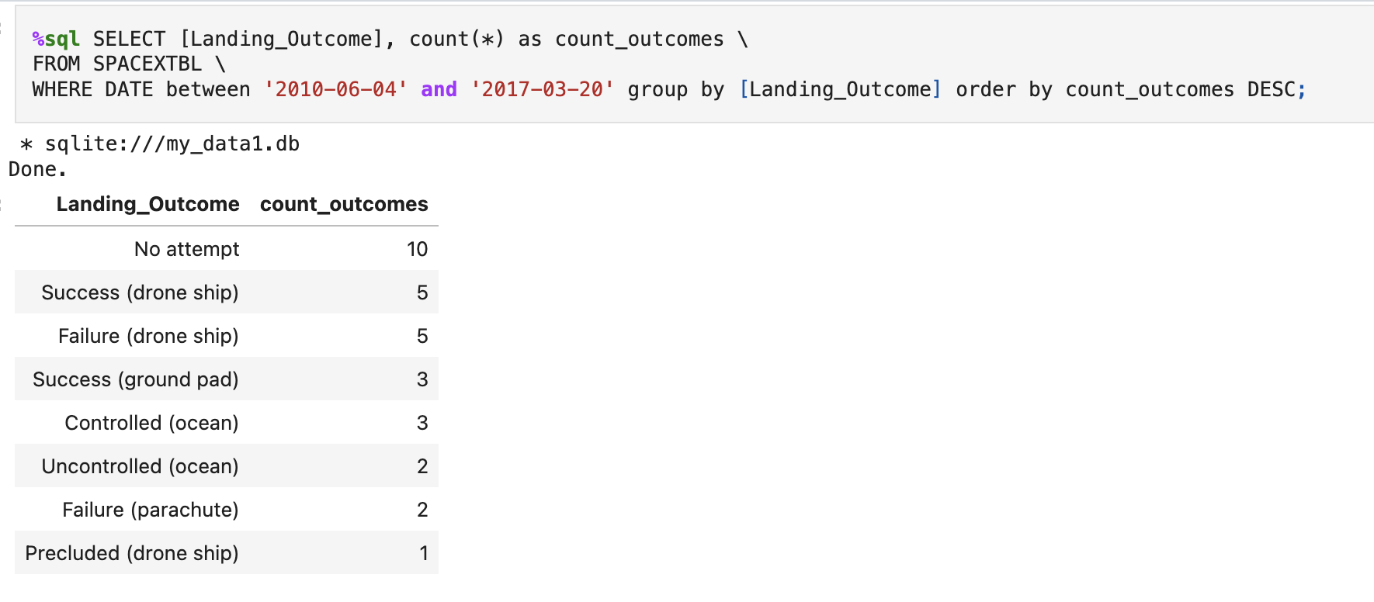
Rank Landing Outcomes Between 2010-06-04 and 2017-03-20
Rank the count of landing outcomes (such as Failure (drone ship) or Success (ground pad)) between the date 2010-06-04 and 2017-03-20, in descending order

Slide 35

Section 3

Slide 36
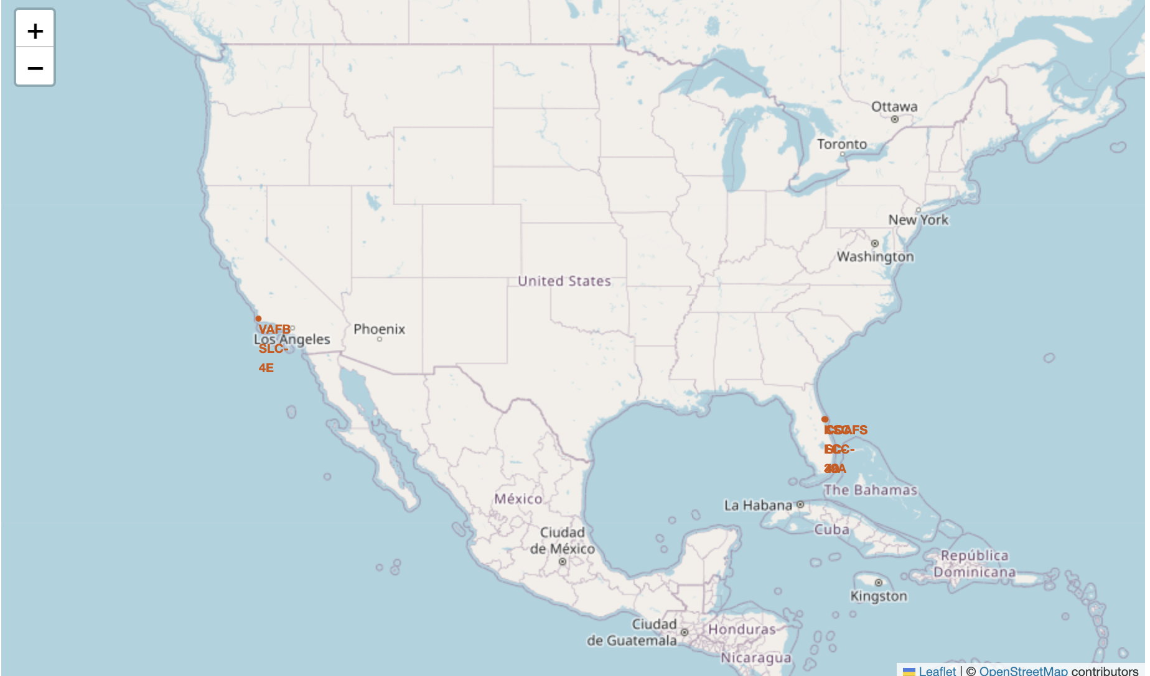
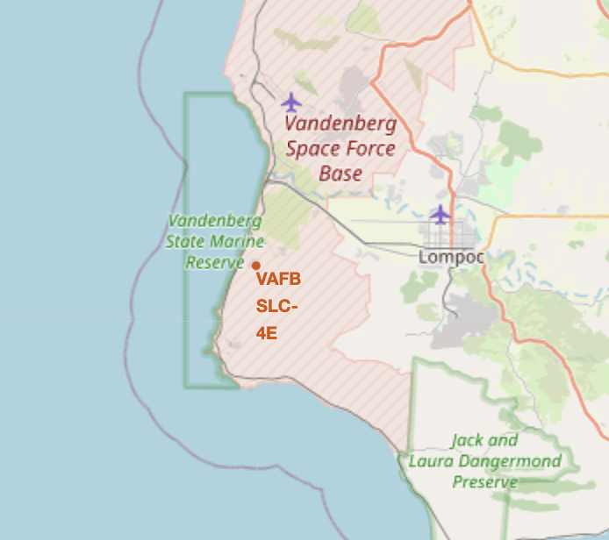
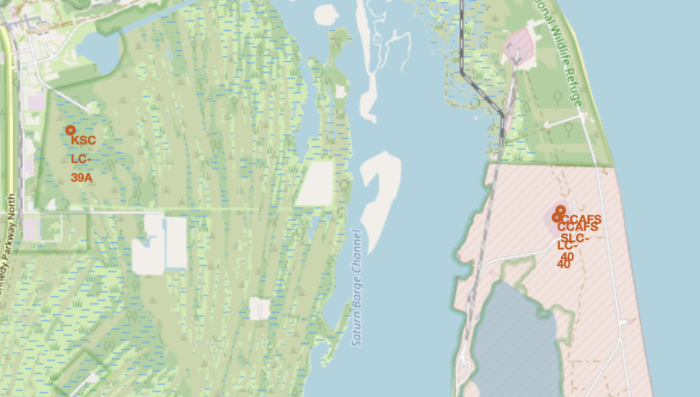
All Launch Sites
Looking at the zoomed in pictures, we notice that there three launch sites very close from each other. All sites are located on the coast.

Slide 37
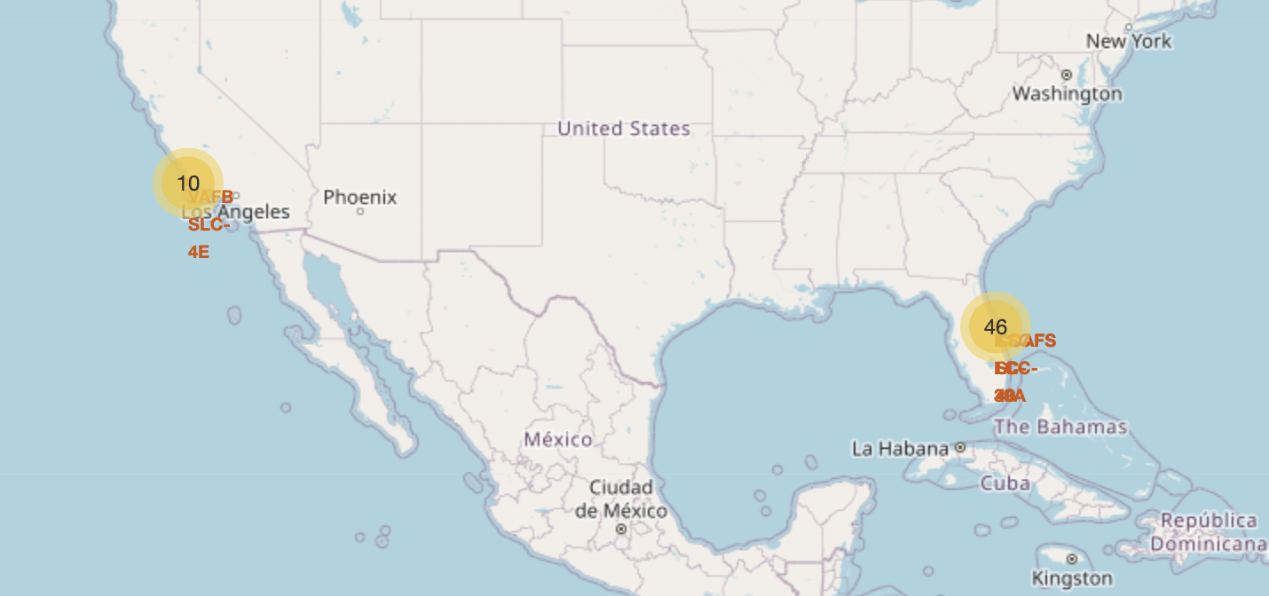
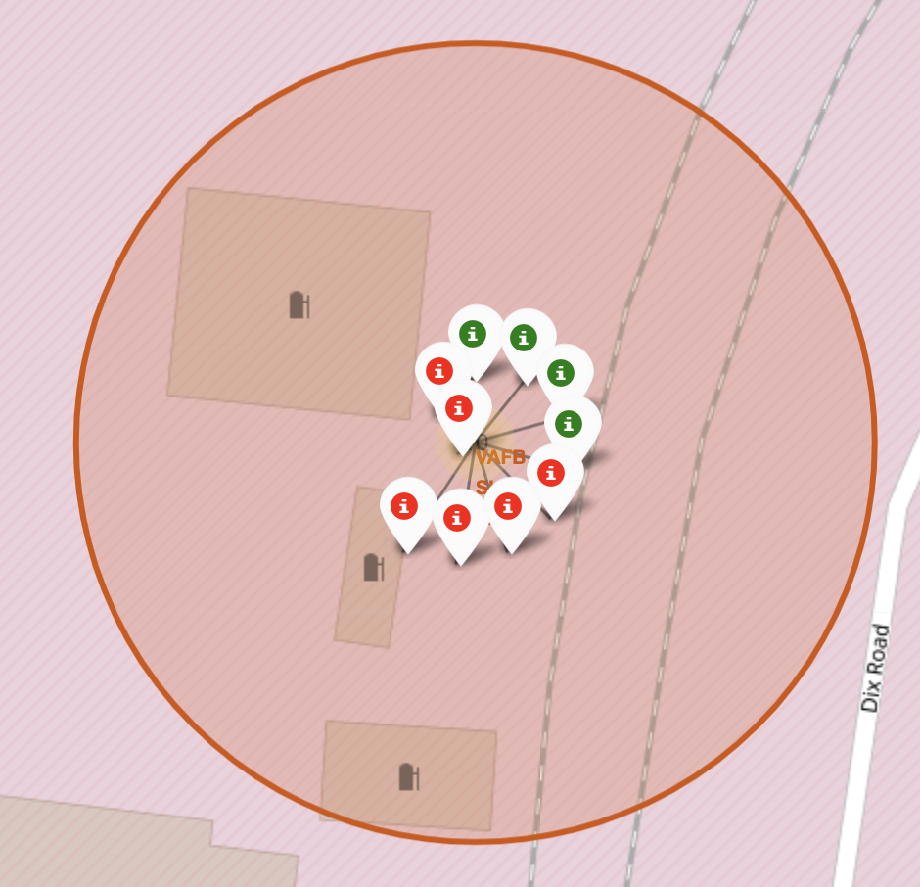
Launches Outcomes
We can see launches clusters on the map for each site. When we zoom in and click on it, we see the success/fail launches represented by green and red colors.

Slide 38
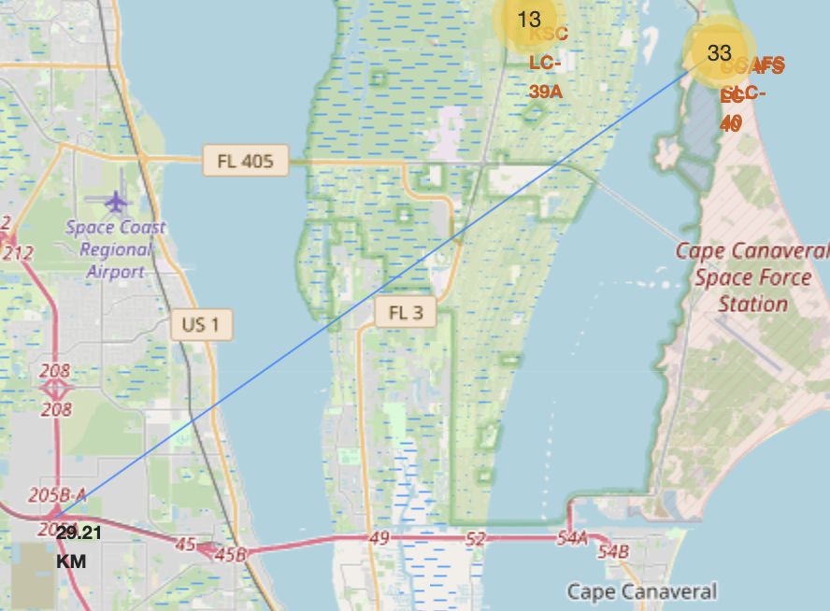
Launch Site to its Proximities
Launch sites are near coastlines, roads and highways. All launch sites maintain safe distance to main cities for safety reasons. The shows a line connecting a launch site to its nearest highway.

Slide 39

Section 4

Slide 40
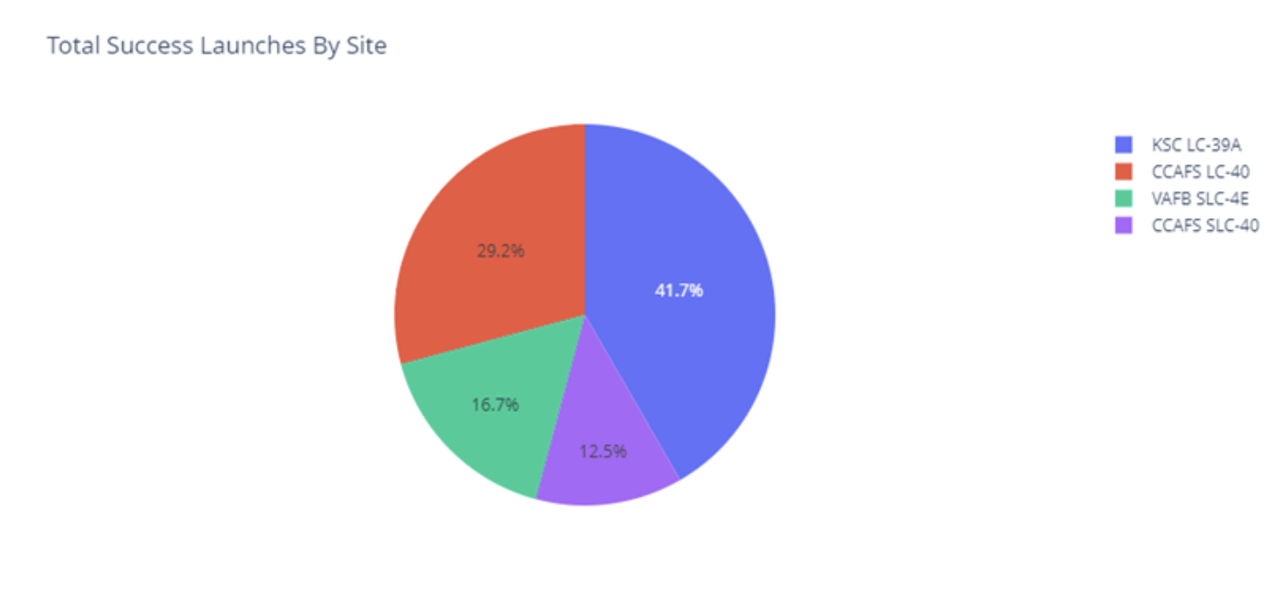
Success Launches
The site KSC LC-39A has highest success launches whils CCAFS SLC-40 has lowest success launches

Slide 41
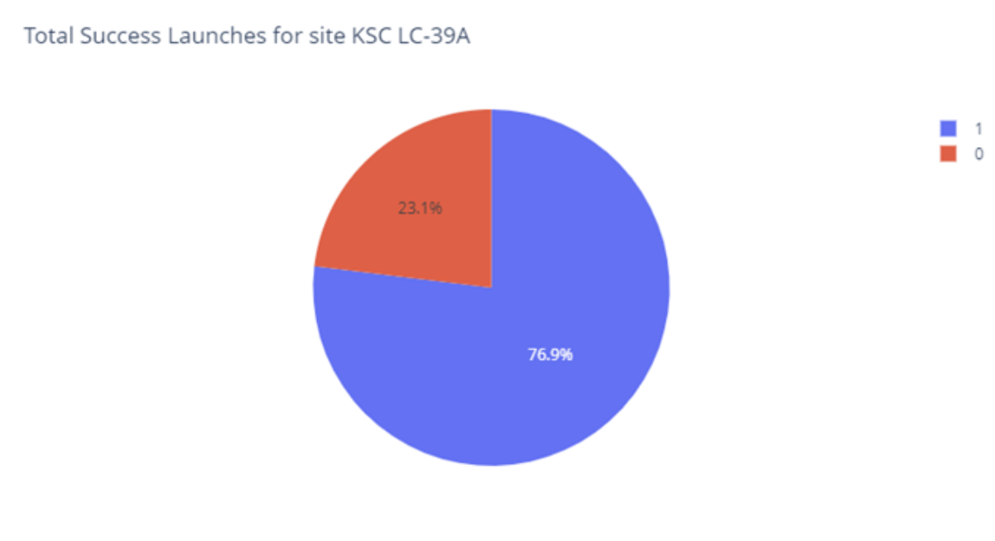
Highest Success Ratio Site
The highest success ratio site KSC LC-39A has 76.9% success ratio

Slide 42
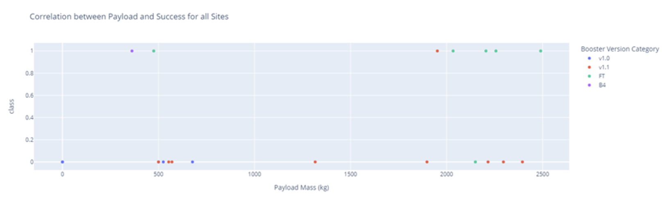
Payload Launch Outcome
Selecting different Payload Mass ranges we notice that the highest success launches are in between 2500kg – 5000kg payload mass.

Slide 43
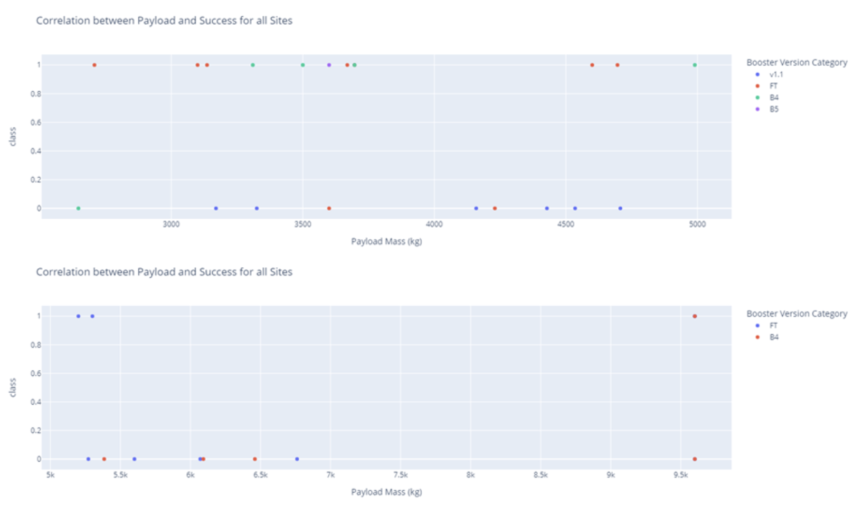
Payload Launch Outcome
Selecting different Payload Mass ranges we notice that the highest success launches are in between 2500kg – 5000kg payload mass.

Slide 44

Section 5

Slide 45
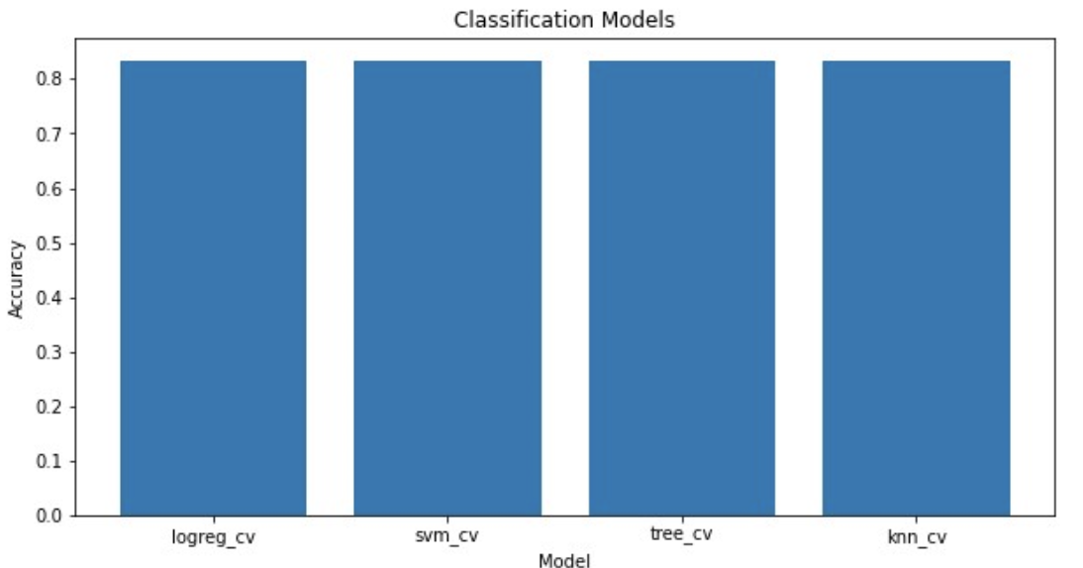
Classification Accuracy
All models have the same accuracy on test data: 0.833
Decision Tree model had the best_score accuracy of 0.8732142857142856

Slide 46
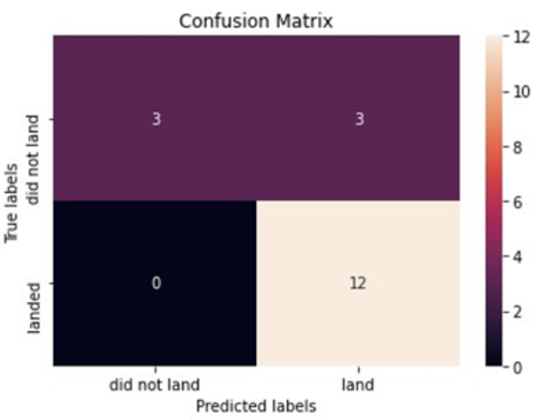
Confusion Matrix
All models had the same confusion matrix.

Slide 47
Conclusions
Using our machine learning models, we can predict whether a launch will have a successful landing or not.
The best model to predict the outcome of the landing is the Decision Tree Model.
We found the Launch site with highest success rate to be KSC LC-39A site.
All launch sites have a safe distance from cities.

Slide 48
Appendix
You can check this Github repository to find the notebooks, codes and results found for this work:
Repository Link

Slide 49


